Slide 1
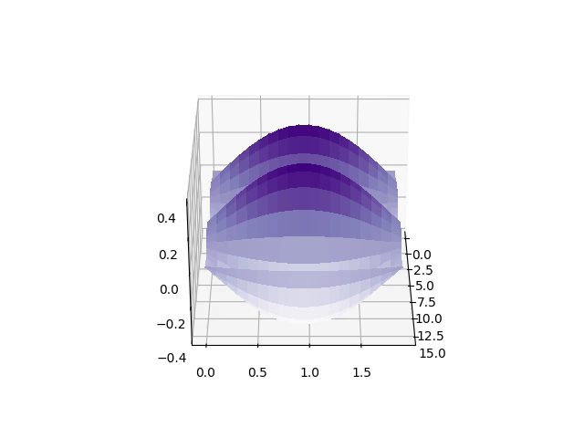

Thinking Outside the Box: A Quantum Transition-State Theory
Mohan Shankar
Egorov Group
April 19th, 2024

Slide 2
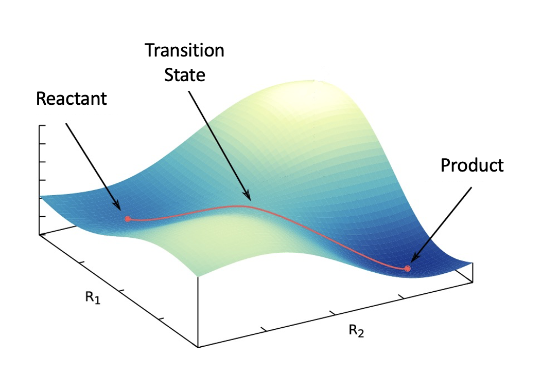

Transition State Theory
Background:
Developed to find chemical reaction rates
Based on classical mechanics
Drawbacks:
Not good for light elements and low temps
Egorov Group
Notes:
CLEAR DIVIDING SURFACE THAT SEPARATES RCTS. AND PRDS.

Slide 3
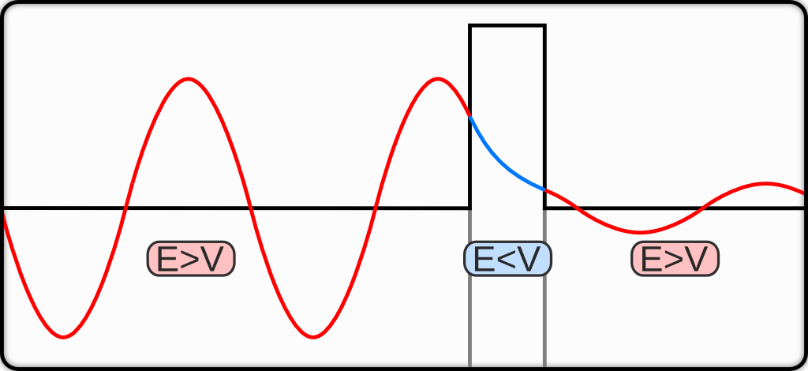
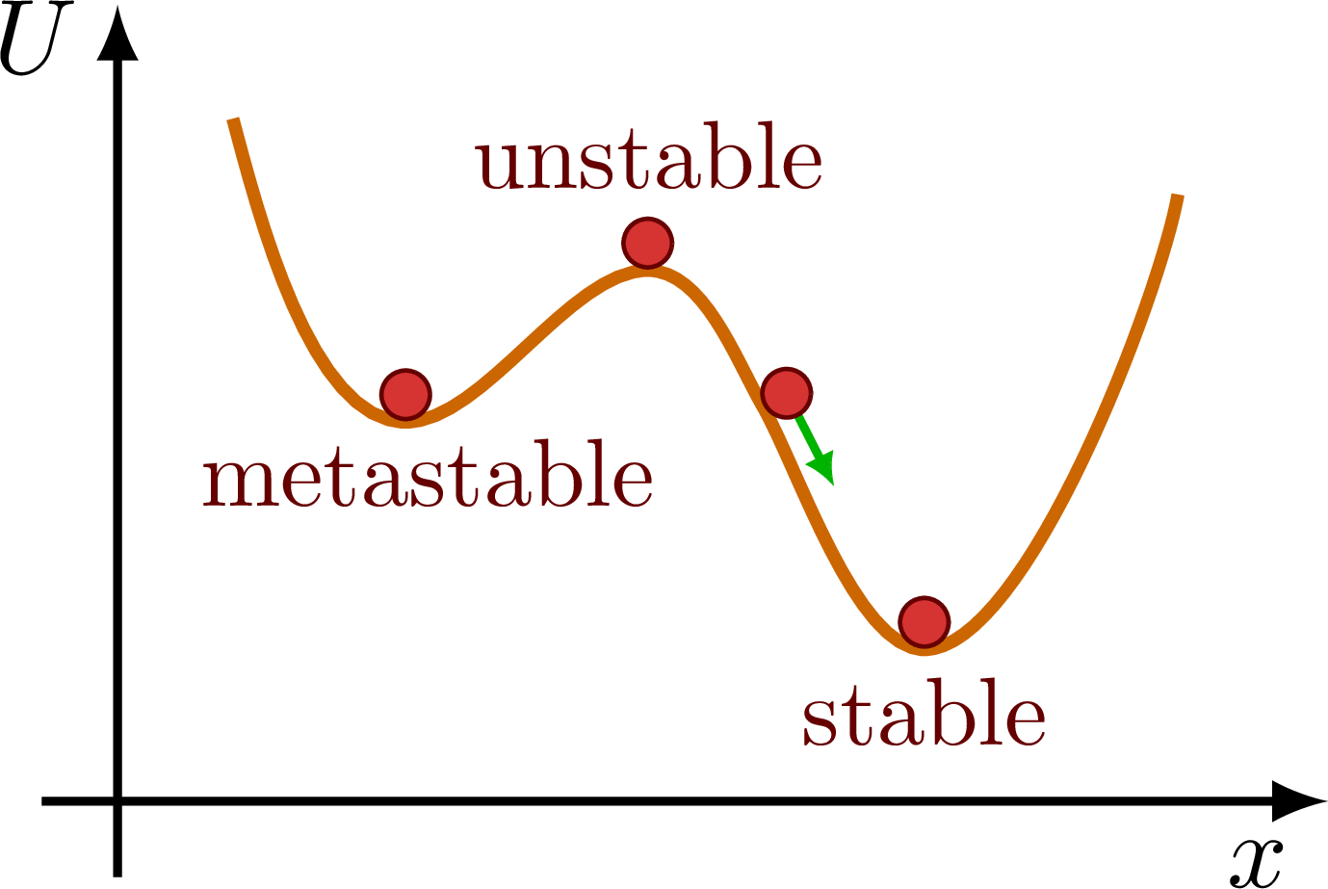
Quantum Effects
Tunneling:
V
Zero Point Energy:
$$E_{n}=\frac{ℏ^{2}π^{2}}{2ml^{2}}n^{2} →ΔxΔp≈ℏ where Δx≈ l and Δp≈\frac{ℏ}{l} → E_{min}≈\frac{Δp^{2}}{2m}≈\frac{ℏ^{2}}{2ml^{2}}≠0$$
Egorov Group

Slide 4
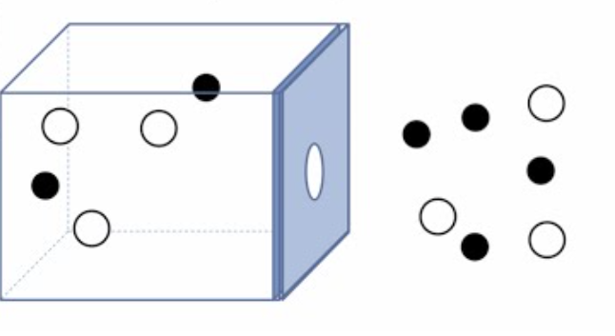
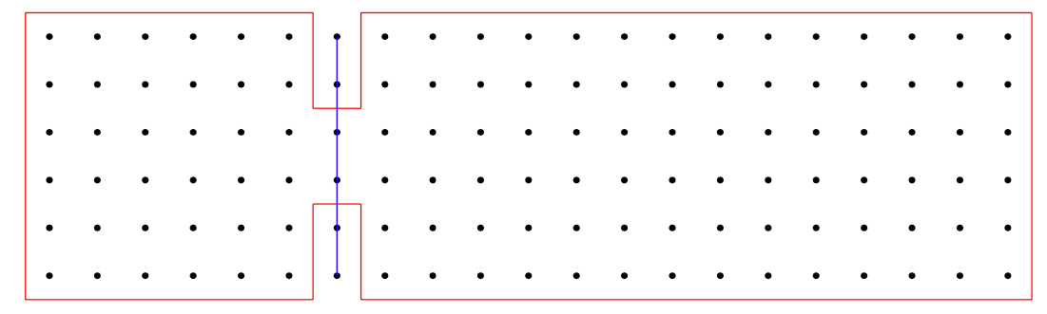
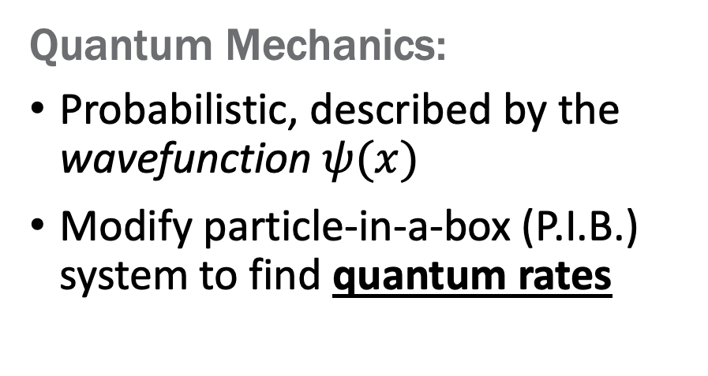
Comparison of Formalisms
Classical Mechanics:
Deterministic, described by x(t) and p(t) of all particles present
Rates of effusion are known
Quantum Mechanics:
Probabilistic, described by the wavefunction $ψ(x)$
Modify particle-in-a-box (P.I.B.) system to find quantum rates
Egorov Group
Notes:
Exact solutions for PIB → Numeric Solutions for new system. Goal is to find rates where quantum effects are accounted for!
Effusion acted as a baseline for TST; quantum effusion as a baseline for QTST
Gap = Dividing Surface here; empty space = products

Slide 5
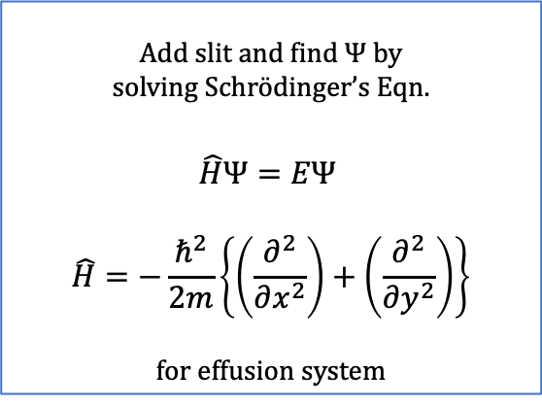
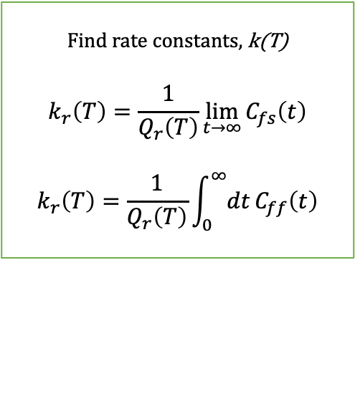
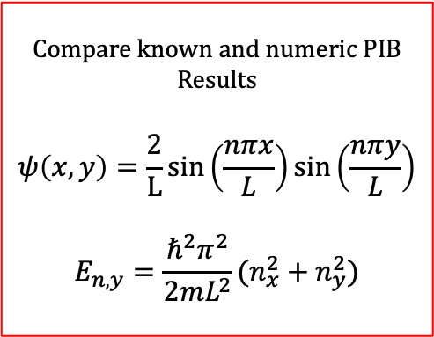
Methodology
Solver Validation
Add Slit
Find Rates
Compare known and numeric PIB Results
$$ψ\left(x,y\right)=\frac{2}{L}sin\left(\frac{nπx}{L}\right)\sin\left(\frac{nπy}{L}\right)$$
$$E_{n,y}=\frac{ℏ^{2}π^{2}}{2mL^{2}}(n_{x}^{2}+n_{y}^{2})$$
Add slit and find $Ψ$ by
solving Schrödinger’s Eqn.
$$\hat{H}Ψ=EΨ$$
$$\hat{H}=−\frac{ℏ^{2}}{2m}\left\{\left(\frac{∂^{2}}{∂x^{2}}\right)+\left(\frac{∂^{2}}{∂y^{2}}\right)\right\}$$
for effusion system
Find rate constants, k(T)
$$k_{r}\left(T\right)=\frac{1}{Q_{r}\left(T\right)}\lim_{t→∞}{C_{fs}\left(t\right)}$$
$$k_{r}\left(T\right)=\frac{1}{Q_{r}\left(T\right)}\int_{0}^{∞}{dt}{C_{ff}\left(t\right)}$$
Egorov Group
Notes:
E and Psi are solutions making them two points to look at for agreement
TOUCH ON CORRELATION FUNCTIONS AND LIMIT

Slide 6
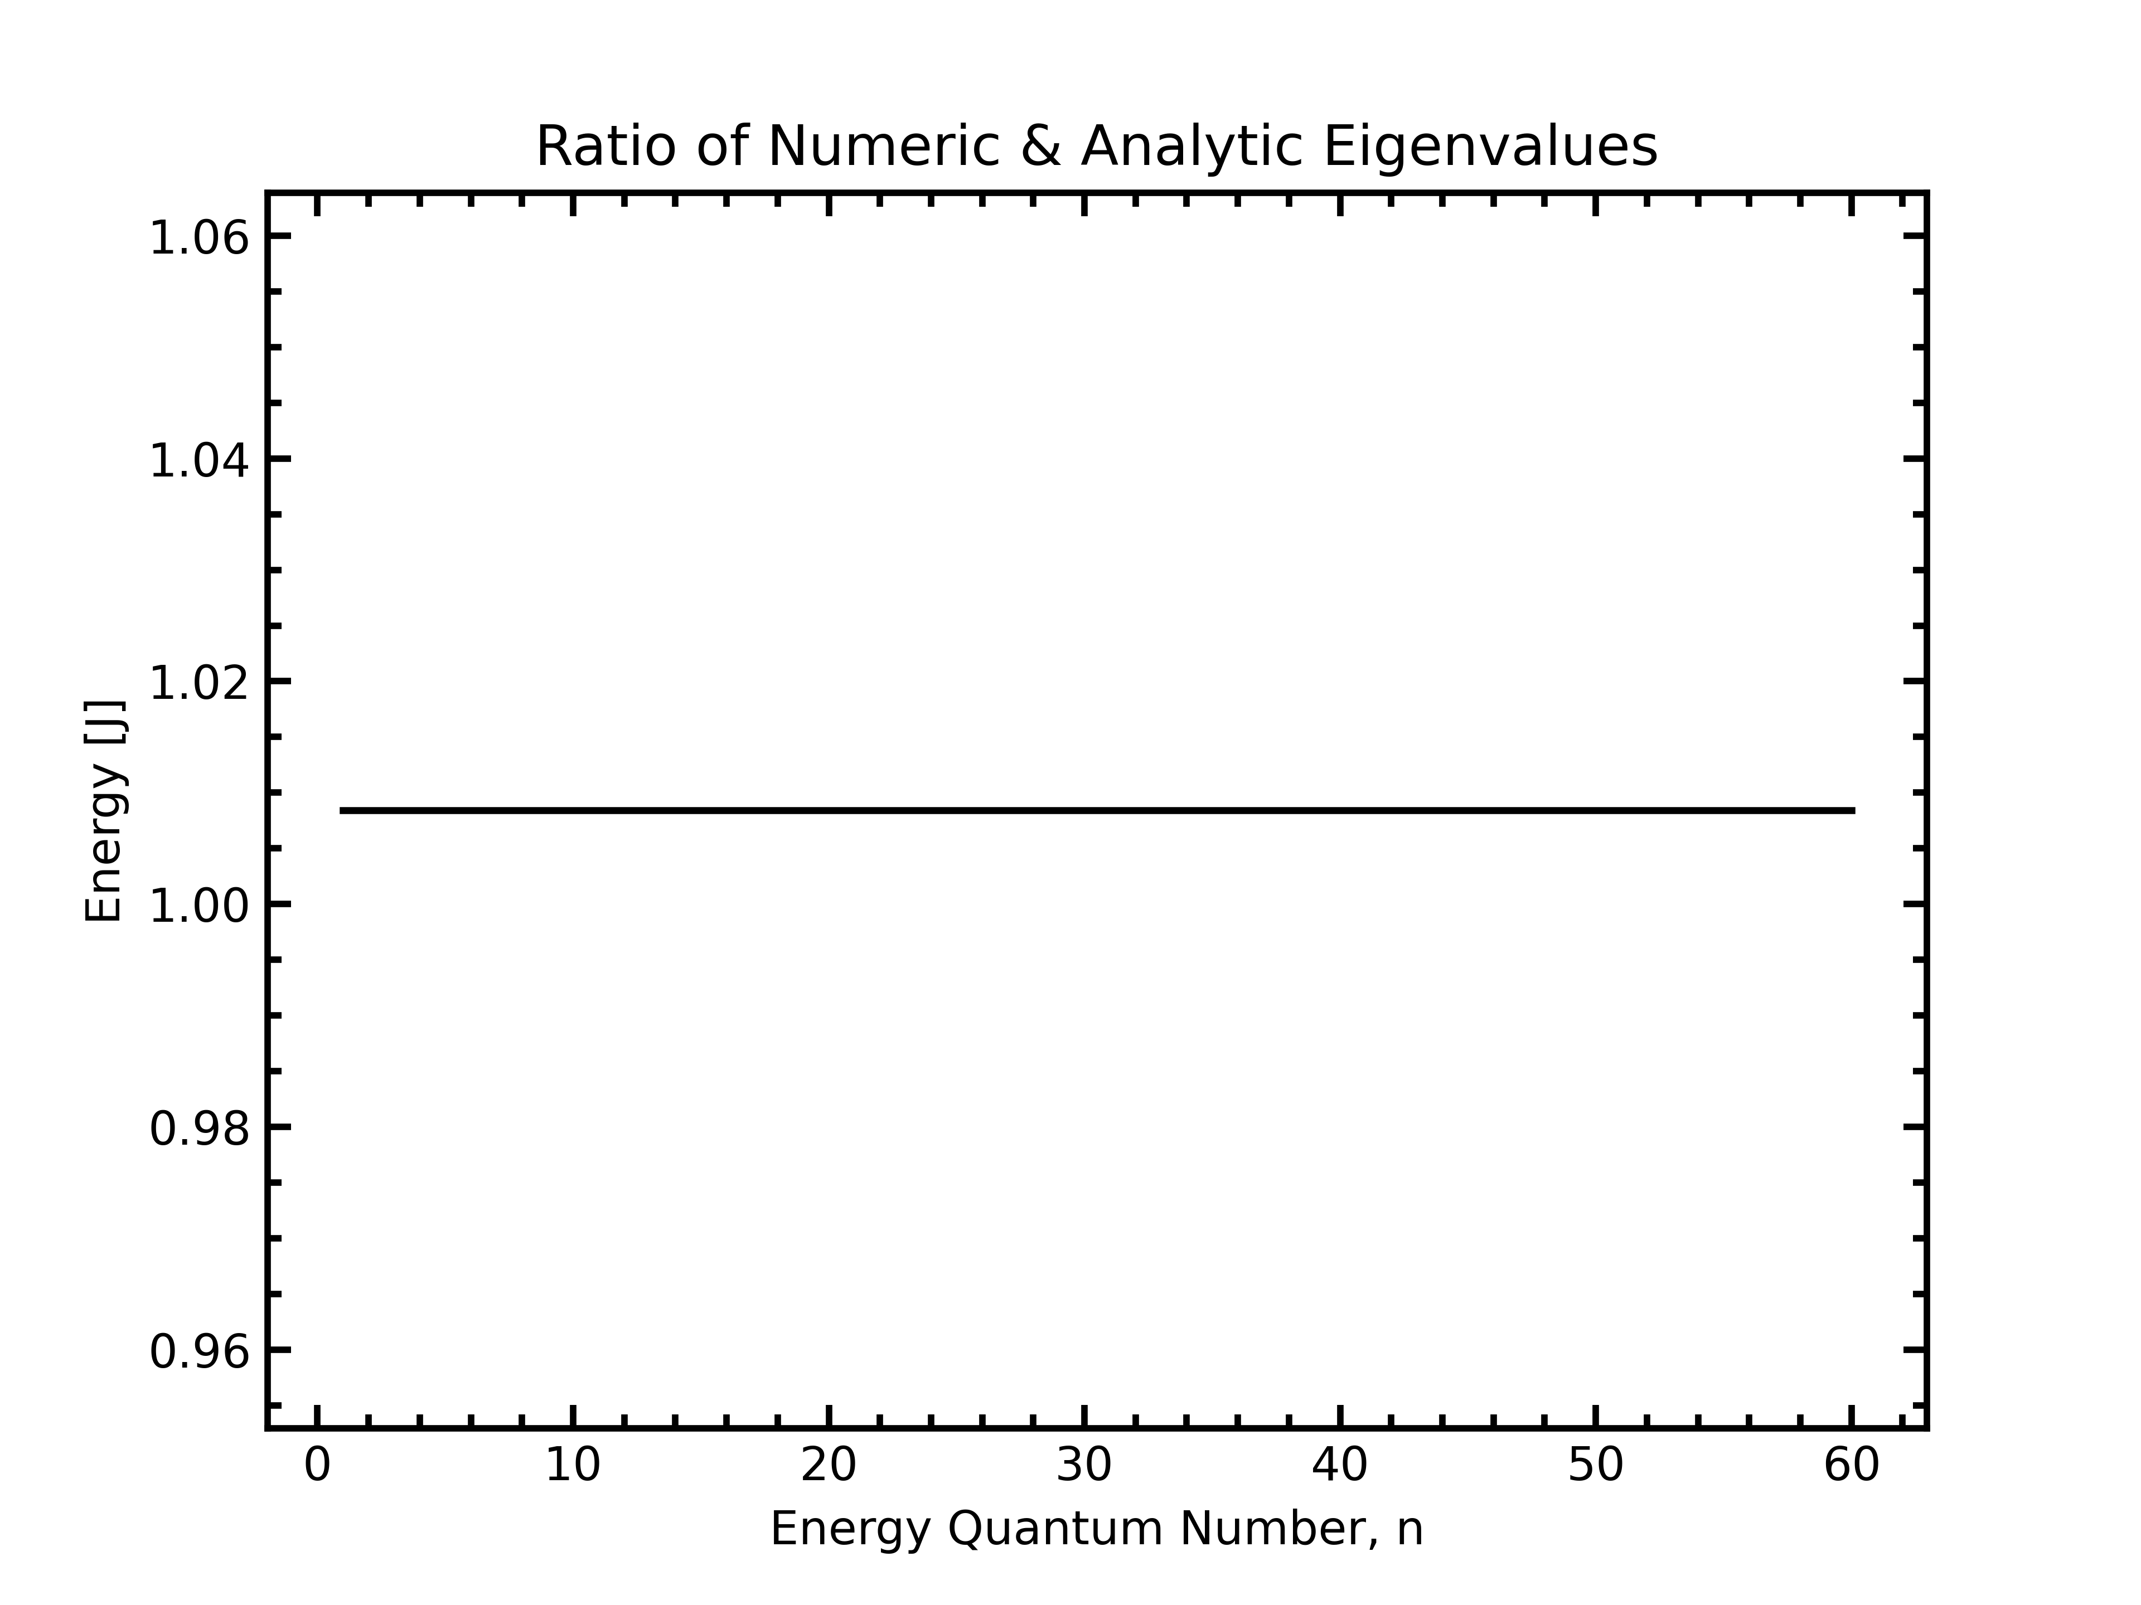
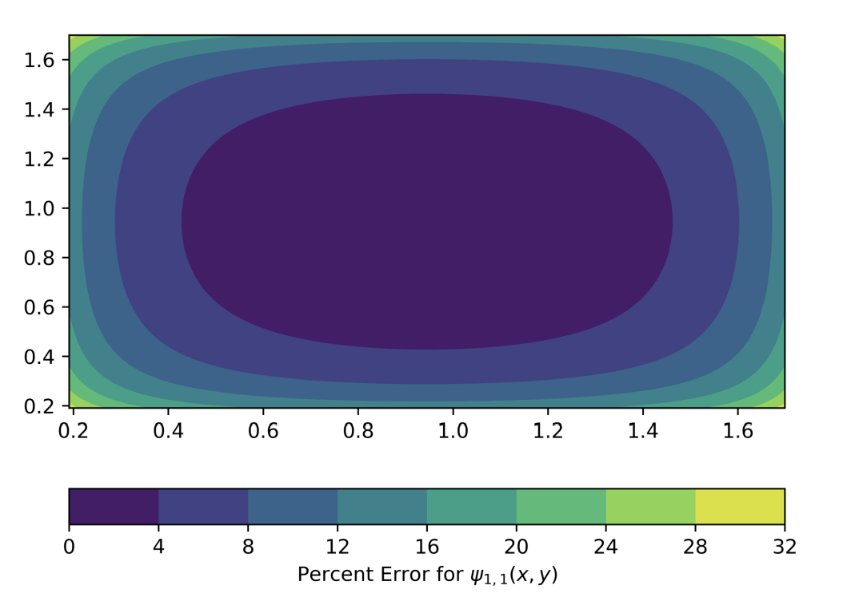
Solver Validation
P.I.B.
Egorov Group
Notes:
Numeric and Analytic match well!
Eigenvalues are ~ e-21 J
Mention boundary conditions

Slide 7
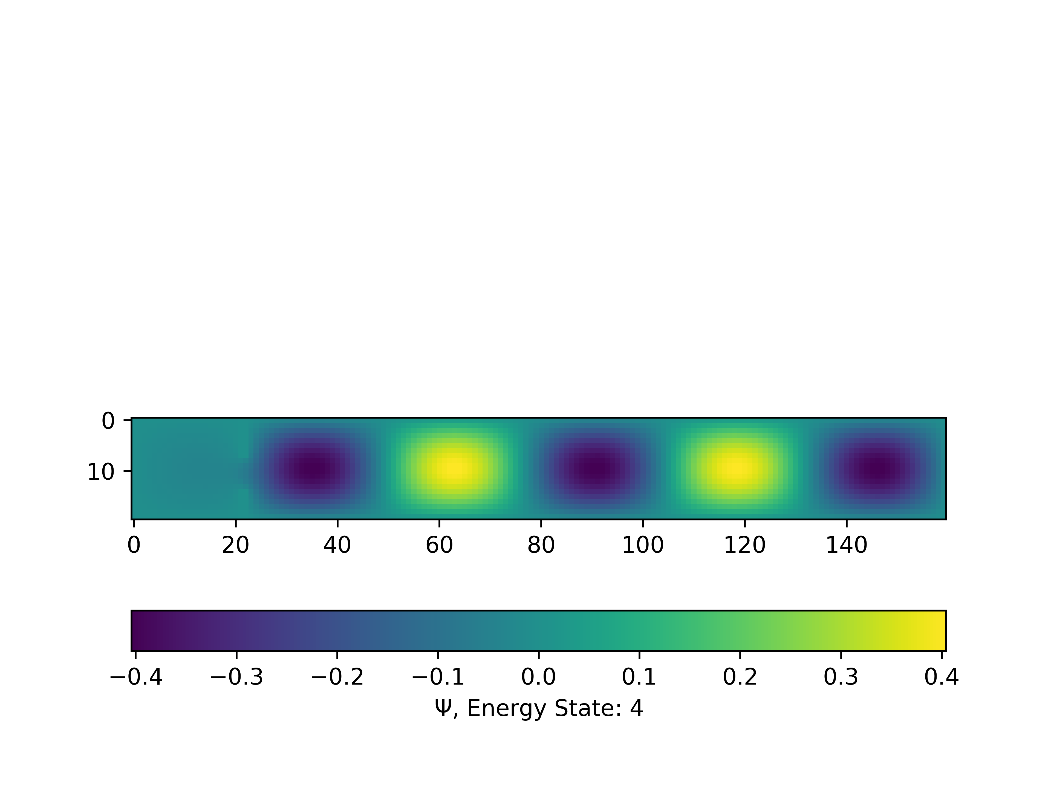
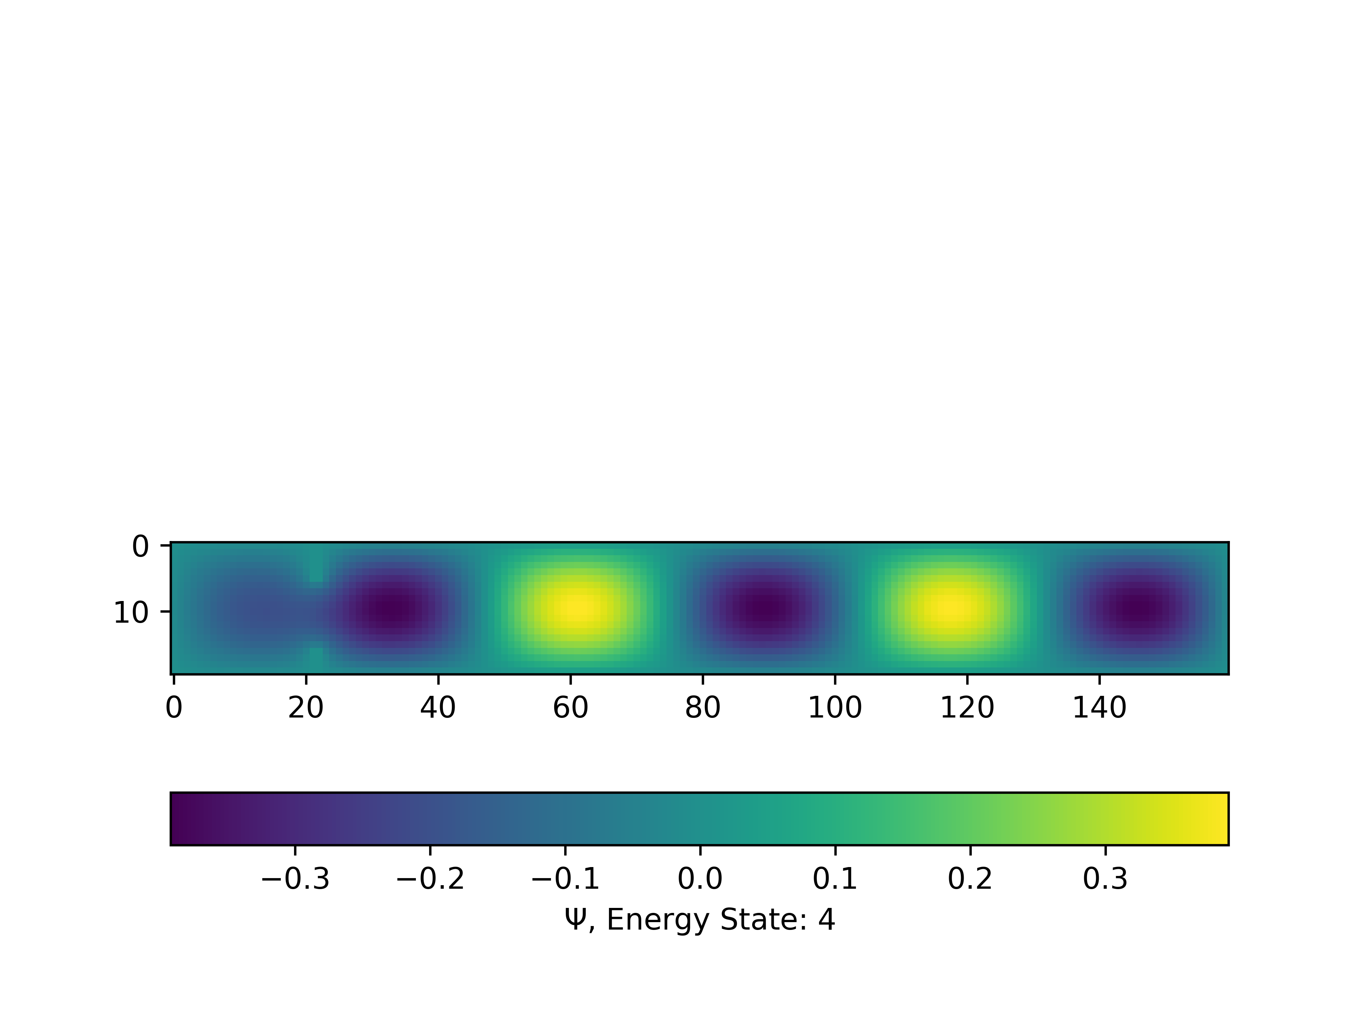
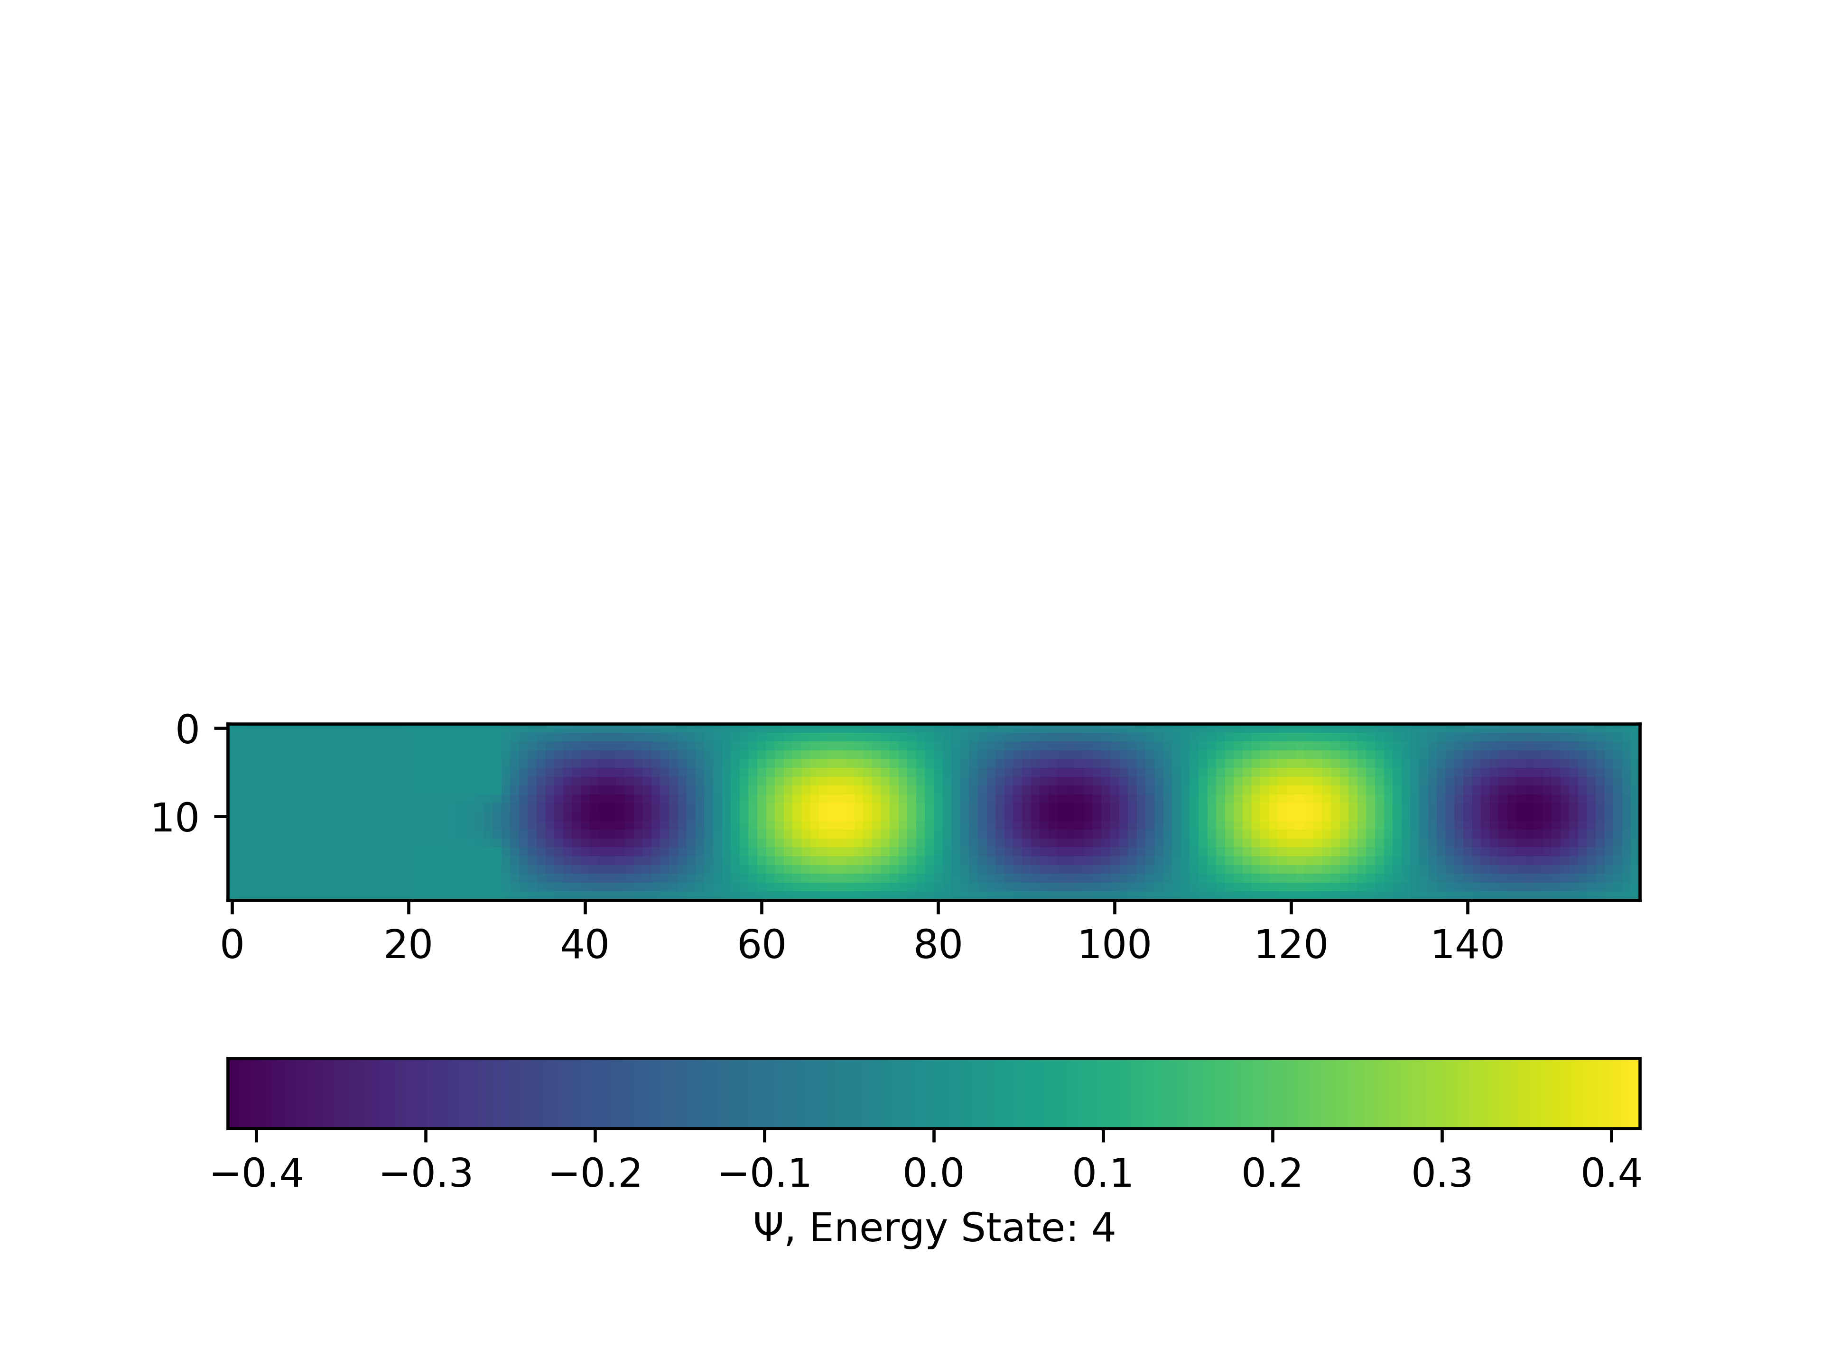
Quantum Effusion
6 PT. Gap, 2 PT. Wall Thickness
10 PT. Gap, 2 PT. Wall Thickness
2 PT. Wall Thickness, 6 PT. Gap
10 PT. Wall Thickness, 6 PT. Gap
Egorov Group
Notes:
VARY GAP SIZE
VARY WALL THICKNESS
NODES DENOTE PROB. DENSITY

Slide 8
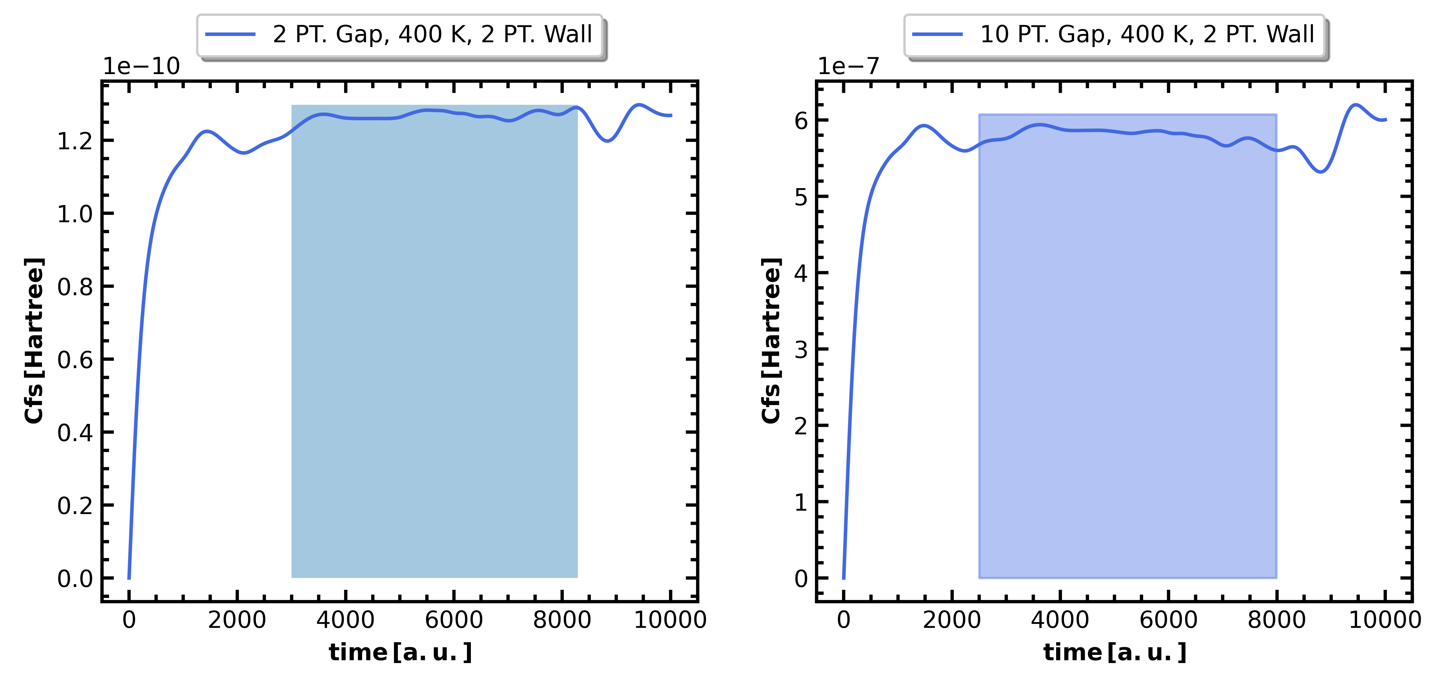
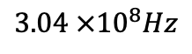
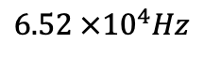
Rates at Different Gap Size
$$6.52 ×{10}^{4}Hz$$
$$3.04 ×{10}^{8}Hz$$
Egorov Group
Notes:
PLATEAU DENOTES WHERE TO FIND RATES AS LONG TIME LIMIT DOES NOT EXIST

Slide 9
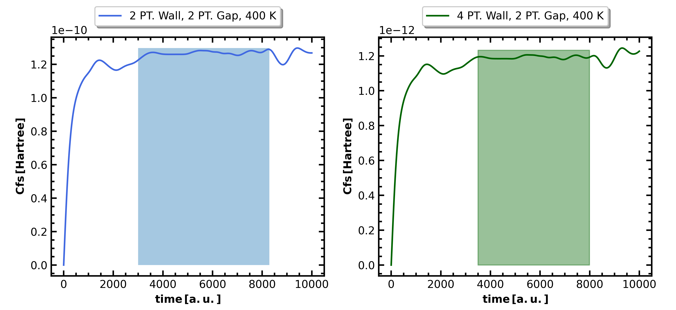
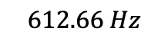
Rates at Different Wall Thickness
$$6.52 ×{10}^{4}Hz$$
$$612.66 Hz$$
Egorov Group

Slide 10
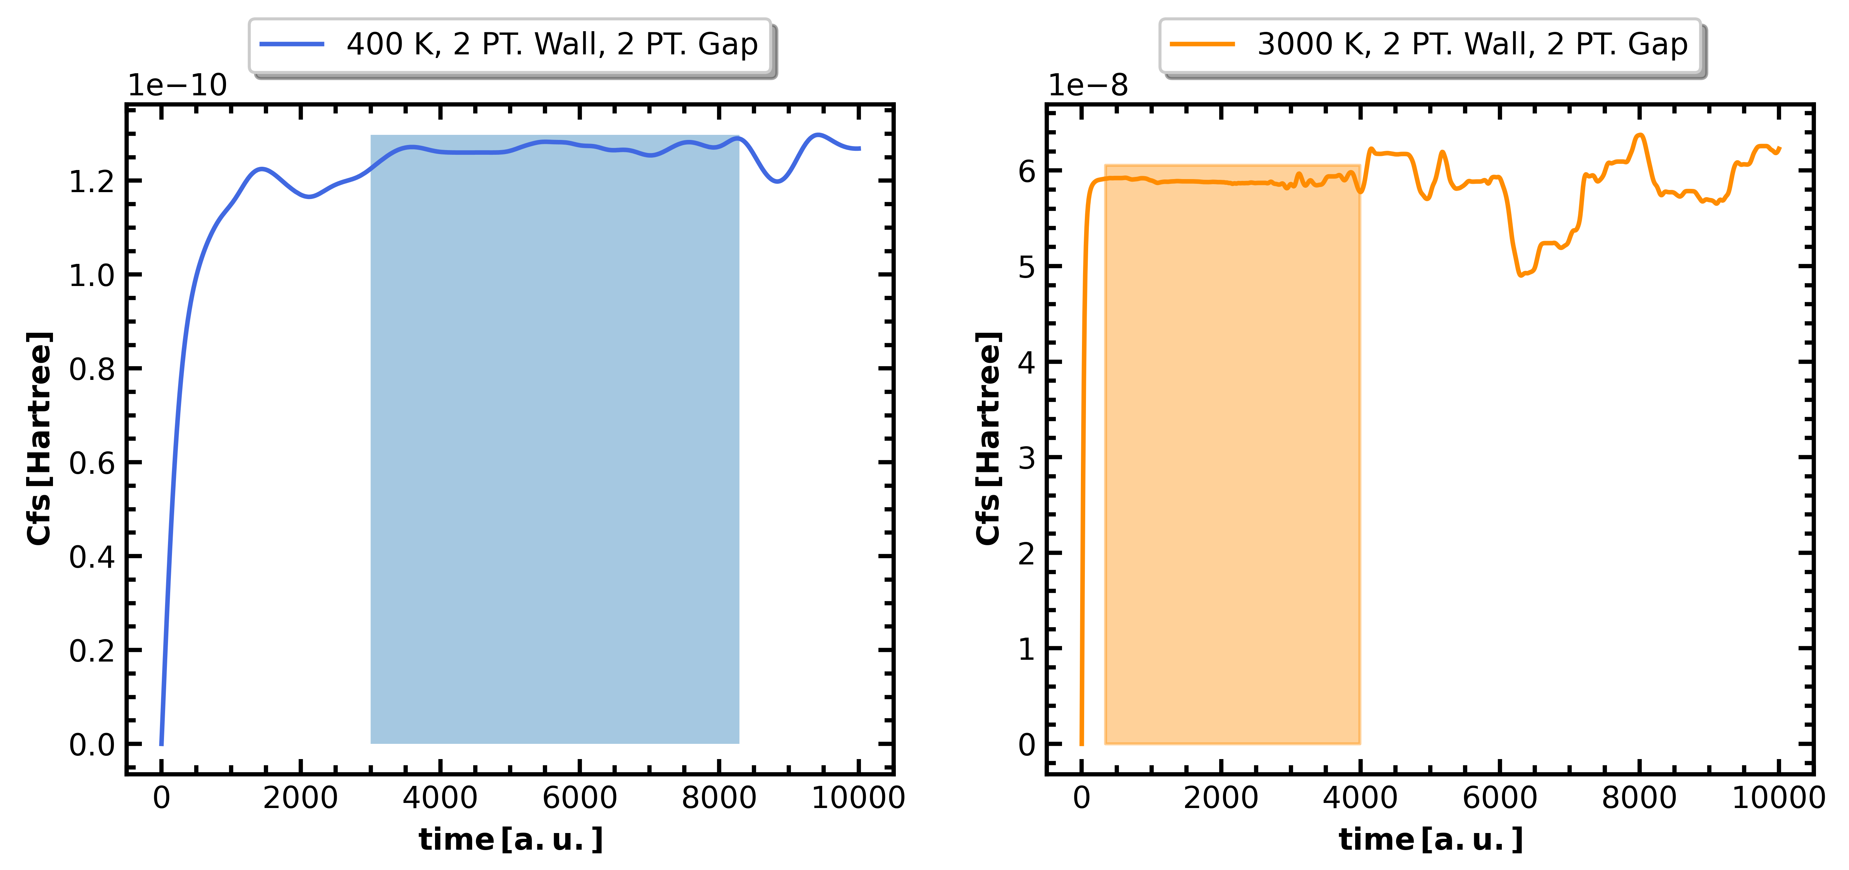
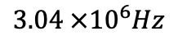
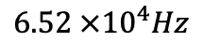
Rates at Different Temperature
$$6.52 ×{10}^{4}Hz$$
$$3.04 ×{10}^{6}Hz$$
Egorov Group

Slide 11
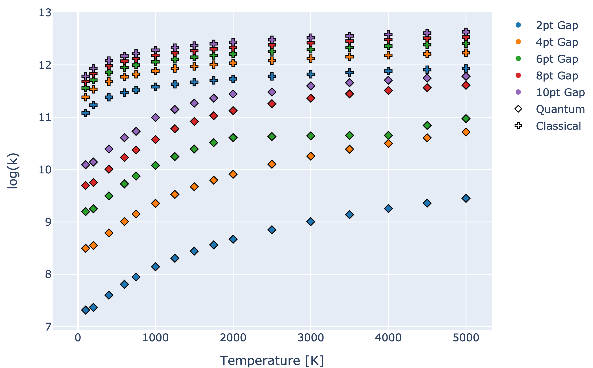
Extrapolated Rates for 0 PT. Wall Thickness
Egorov Group
Notes:
Kq << Kc
Correspondence principle
Same trend where inc. temp and gap size results in greater rate

Slide 12
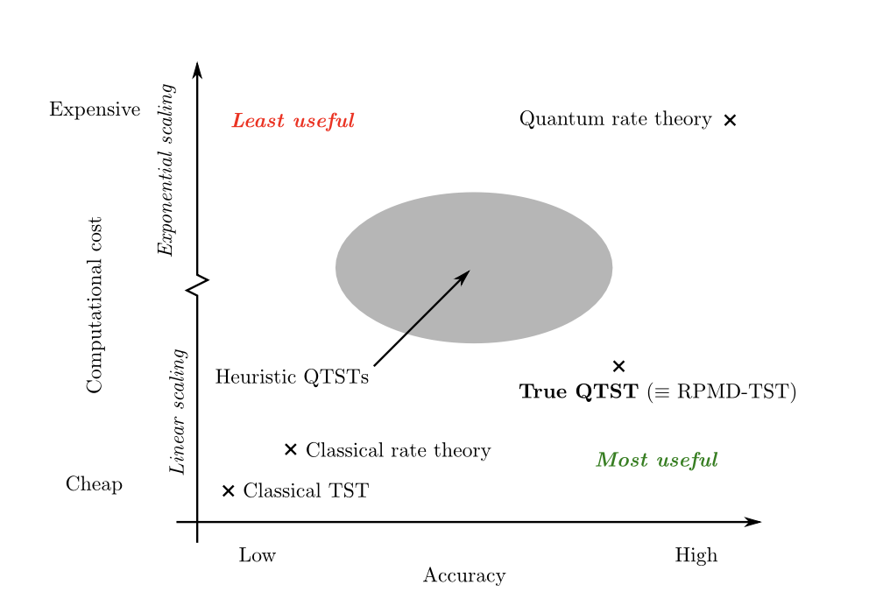
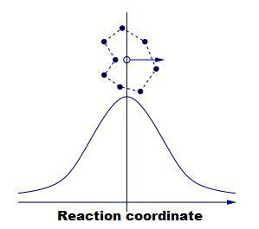
Future Work
RPMD
arXiv:1408.0996

Slide 13
Thank you! Any Questions?
Egorov Group

Slide 14
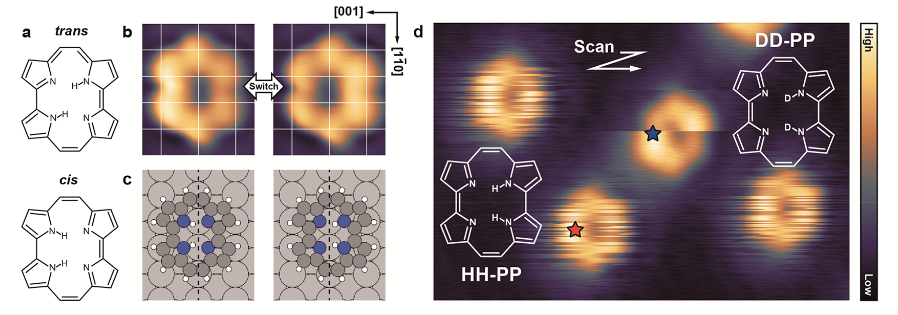
Double Hydrogen Transfer via Tunneling
J. Am. Chem. Soc. 2017, 139, 36, 12681–12687
Notes:
Porphycene molecule; Hydrogen, 5 KELVIN

Slide 15
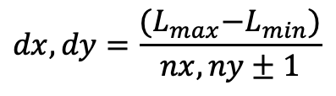
Discretization
$$dx, dy=\frac{{(L}_{max}−L_{min})}{nx, ny±1}$$

Slide 16
Discretization
≅
$$dx, dy=\frac{{(L}_{max}−L_{min})}{nx, ny±1}$$

Slide 17
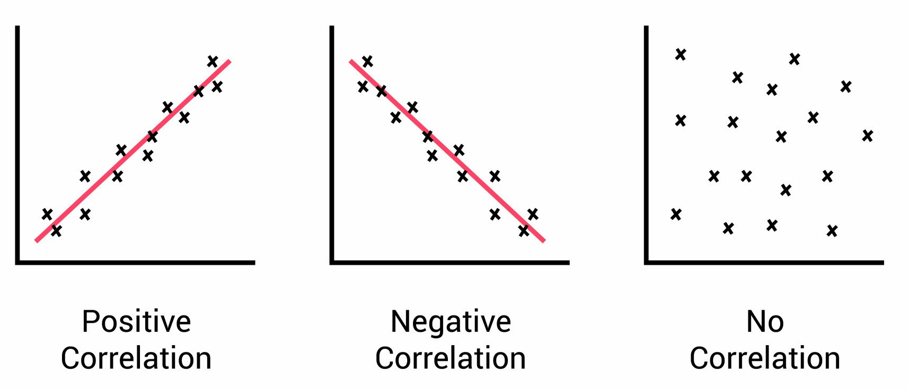
C_{fs} Functions
Flux:
Number of particles through an area over time
Side:
Product side of system
Correlation Function:
Describes a statistical relationship b/t quantities

Slide 18
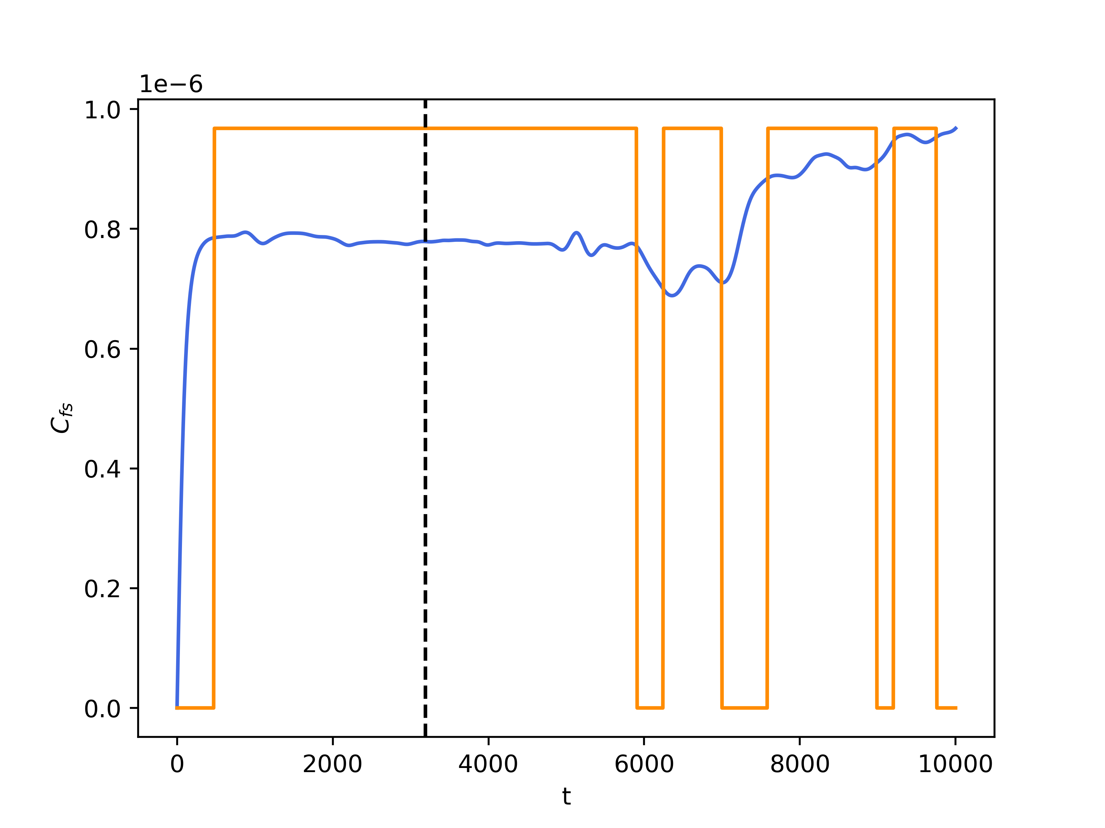
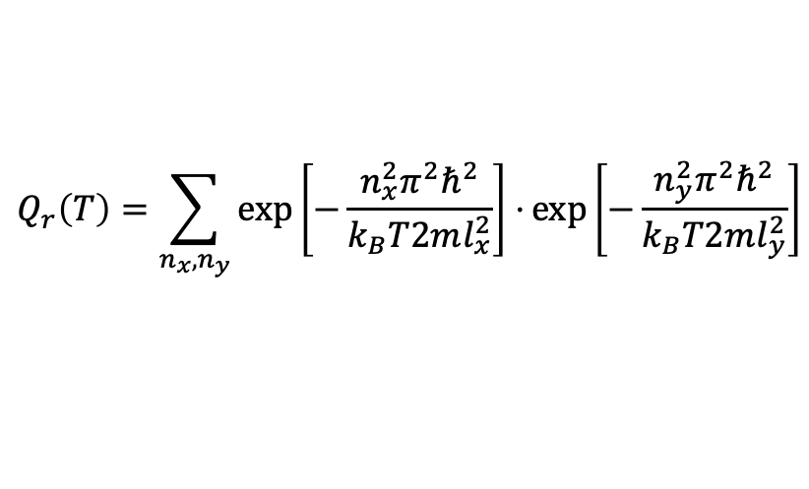
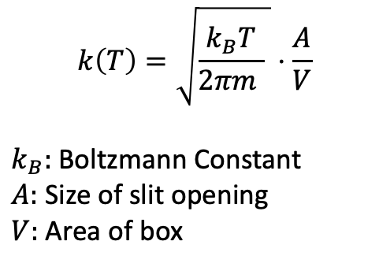
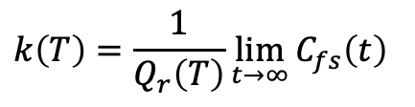
Finding Rates
Classical Approach
Quantum Approach
$$k\left(T\right)=\sqrt{\frac{k_{B}T}{2πm } }⋅\frac{A}{V}$$
$k_{B}:$ Boltzmann Constant
$A:$ Size of slit opening
$V:$ Area of box
$$k\left(T\right)=\frac{1}{Q_{r}\left(T\right)}\lim_{t→∞}{C_{fs}\left(t\right) }$$
$$Q_{r}\left(T\right)=\sum_{n_{x}, n_{y}}{\exp\left[−\frac{n_{x}^{2}π^{2}ℏ^{2}}{k_{B}T2ml_{x}^{2}}\right]⋅\exp\left[−\frac{n_{y}^{2}π^{2}ℏ^{2}}{k_{B}T2ml_{y}^{2}}\right]}$$

Slide 19
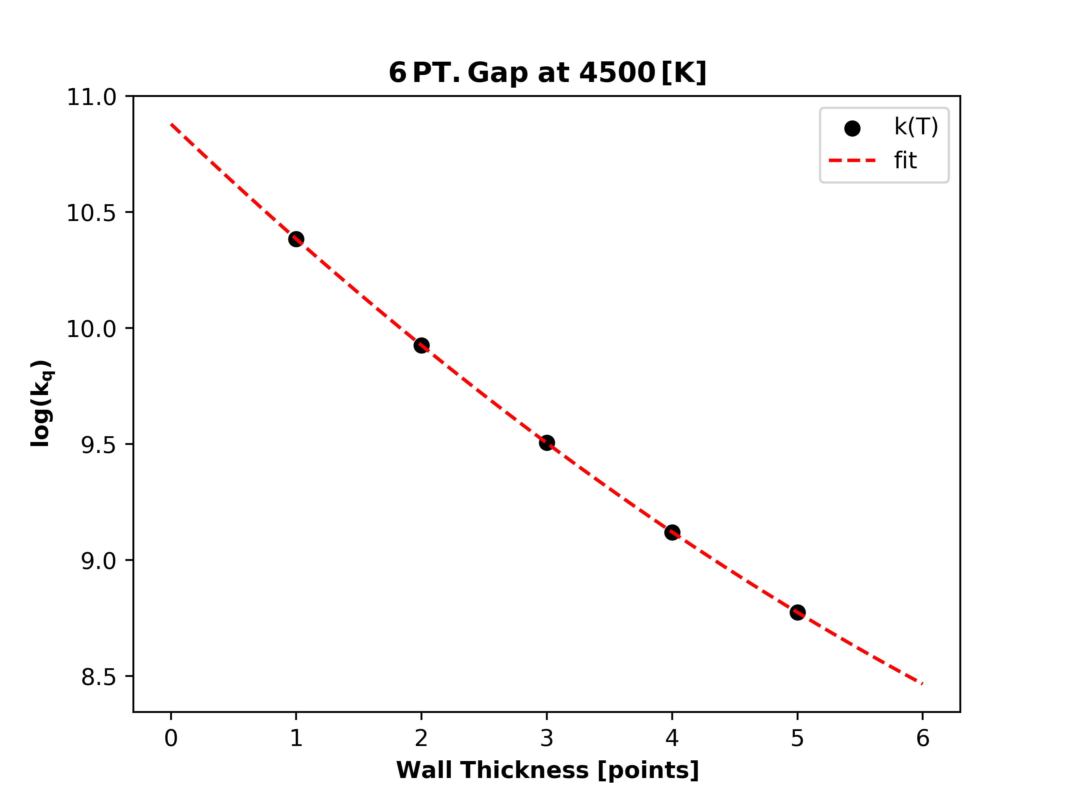
Extrapolating Rates
Notes:
10.879 ± 0.002 → 7.58e10 Hz

Slide 20
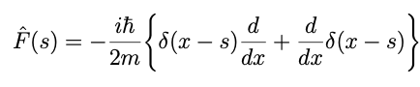
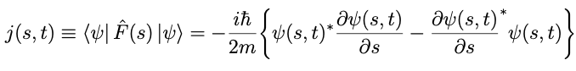
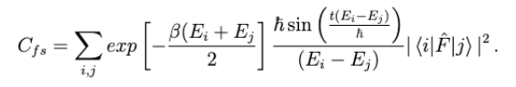
Kinetics using Correlation Functions
“Quantum mechanical rate constants for bimolecular reactions”.
Chem Phys 79 (Nov. 1983), pp. 4889–4898.

